Slide 1
Time Complexity & Big O
By Samman Ashraf

Slide 2
Time Complexity
Data Structures tells us about the time complexity.
Time Complexity is a way of showing how the runtime of a function increases as the size of the input increases.
How you will decide which software is good?
Easy to use
If size is large it runs efficiently.
Software 1 Software 2 Software 3

Slide 3
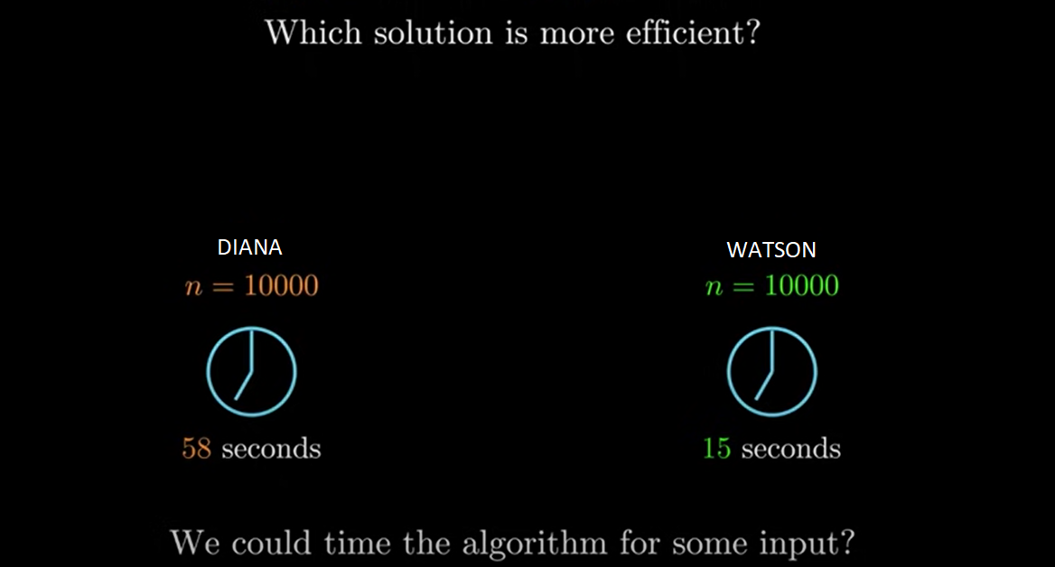
Complexity Analysis

Slide 4
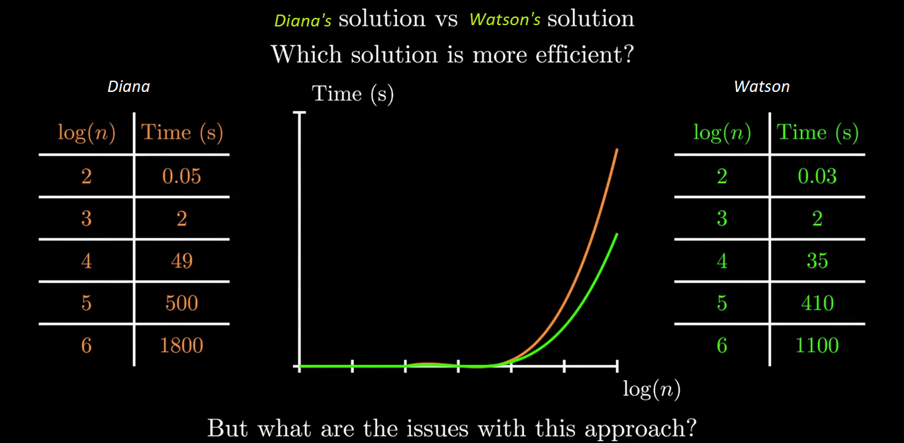
Complexity Analysis

Slide 5
Problem with previous solution
This is machine dependent
We want solution which is machine independent ☺

Slide 6
Three cases
t1 < t2
t2 is the upper bound of t1
Or t1 is upper bounded by t2
t1 is strictly smaller than t2
t1>t2
t1 is the upper bound of t2
Or t2 is upper bounded by t1
t1 is strictly greater than t2
t1 is strictly smaller than t2
t1=t2

Slide 7
Time Complexity
Linear time → 0(n)
Constant time → 0(1)
Quadratic time → O (n^2)

Slide 8
Let’s suppose
Time to run your function is
T = an + b = O (n)
T = cn^2 + dn + e = O (n^2)
Find the fastest growing term.
Take out the coefficient.

Slide 9
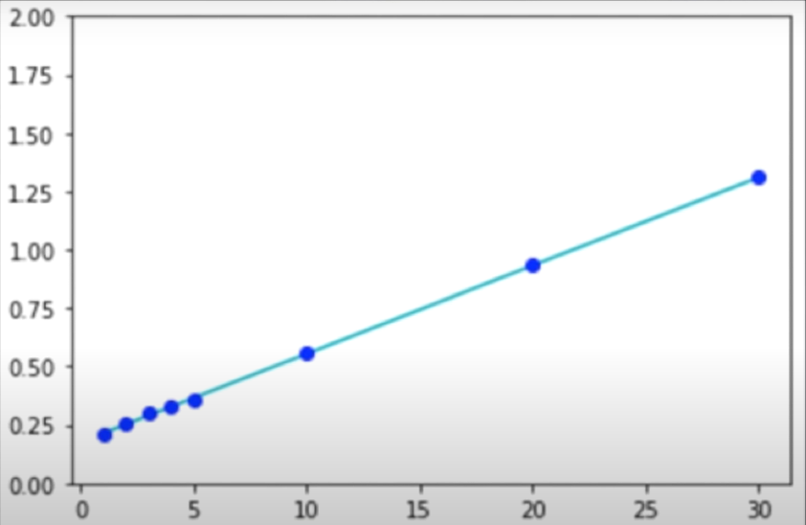
Linear Time
arr = {1,2,3,4,5,6,7,8,9,10}
int sumOfArray(int arr[])
{
sum =0;
for(int i=0 ; i<n; i++)
{
sum = sum + i;
}
Return sum; }

Slide 10
Linear Time
arr = {1,2,3,4,5,6,7,8,9,10}
int sumOfArray(int arr[])
{
sum =0; // T= c = c * 1 =O(1)
for(int i=0 ; i<n; i++) //0(N)
{
sum = sum + i; //0(1)
}
return sum; // O(1) }
T = O(1) + N * O(1) + O(1)
T = O(N)

Slide 11
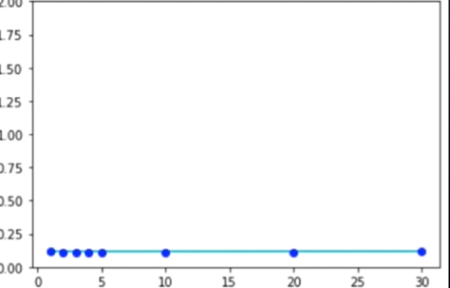
Constant Time
arr = {1,2,3,4,5,6,7,8,9,10}
int AnotherFunction(int arr[])
{
sum =0; //T = c
return sum; // O (1) }
T = c * 1 = O (1)
T = O(1) + O(1)
T = c1 + c2 = c3
C3 = c3 * 1 = O (1)

Slide 12
QuadraticTime
2Arr = {{1,2,3}, {4,5,6},{7,8,9}}
int sumOfArray2D(int arr[][])
{
sum =0;
for(int i=0 ; i<row; i++)
for(int j=0;j<col;j++)
sum = sum + i;
return sum; }

Slide 13
Quadratic Time
2Arr = {{1,2,3}, {4,5,6},{7,8,9}}
int sumOfArray2D(int arr[][])
{
sum =0; //O(1)
for(int i=0 ; i<row; i++) 0(N)
for(int j=0;j<col;j++) O(N)
sum = sum + i; O(1)
return sum; //O(1) }
T = O(1) + N^2 * O(1) + O(1)
T = O (N^2)

Slide 14
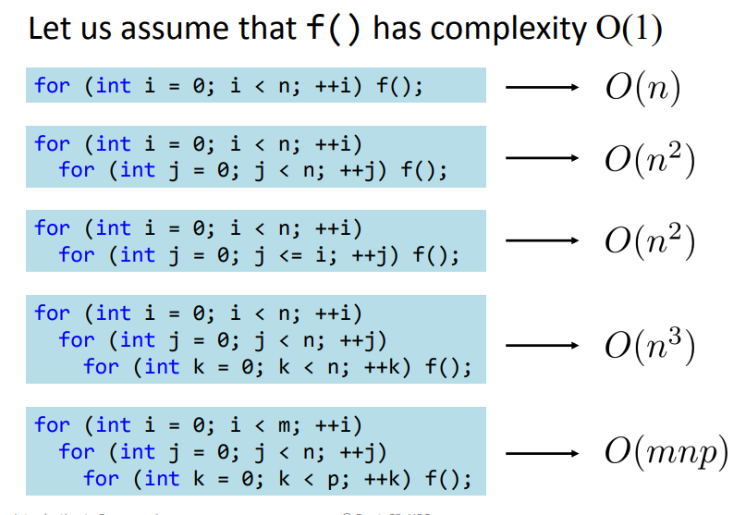
Complexity Analysis

Slide 15
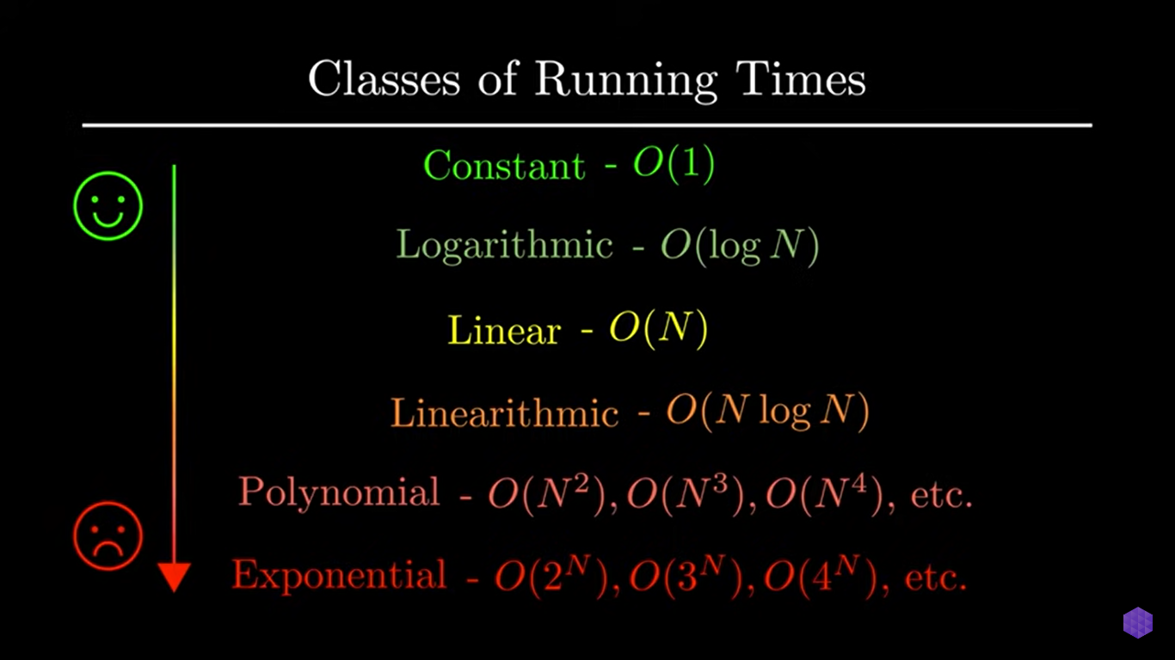

Slide 16
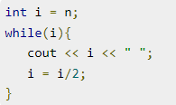
What is the time complexity?

Slide 17
What is the time complexity?
Time complexity is O(Log n)

Slide 18

What is the time complexity?

Slide 19
What is the time complexity?
Time complexity is 0(1)

Slide 20
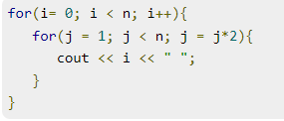
What is the time complexity?

Slide 21
What is the time complexity?
Time complexity is 0(n Log n)

Slide 22
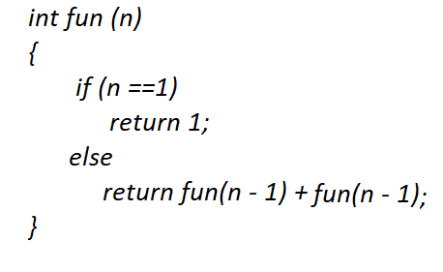
What is the time complexity?

Slide 23
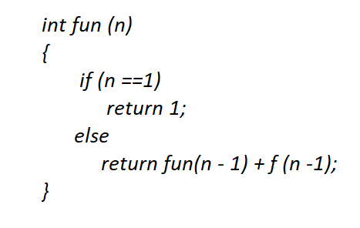
What is the time complexity?
Time complexity is exponential 0(2^n)

Slide 24
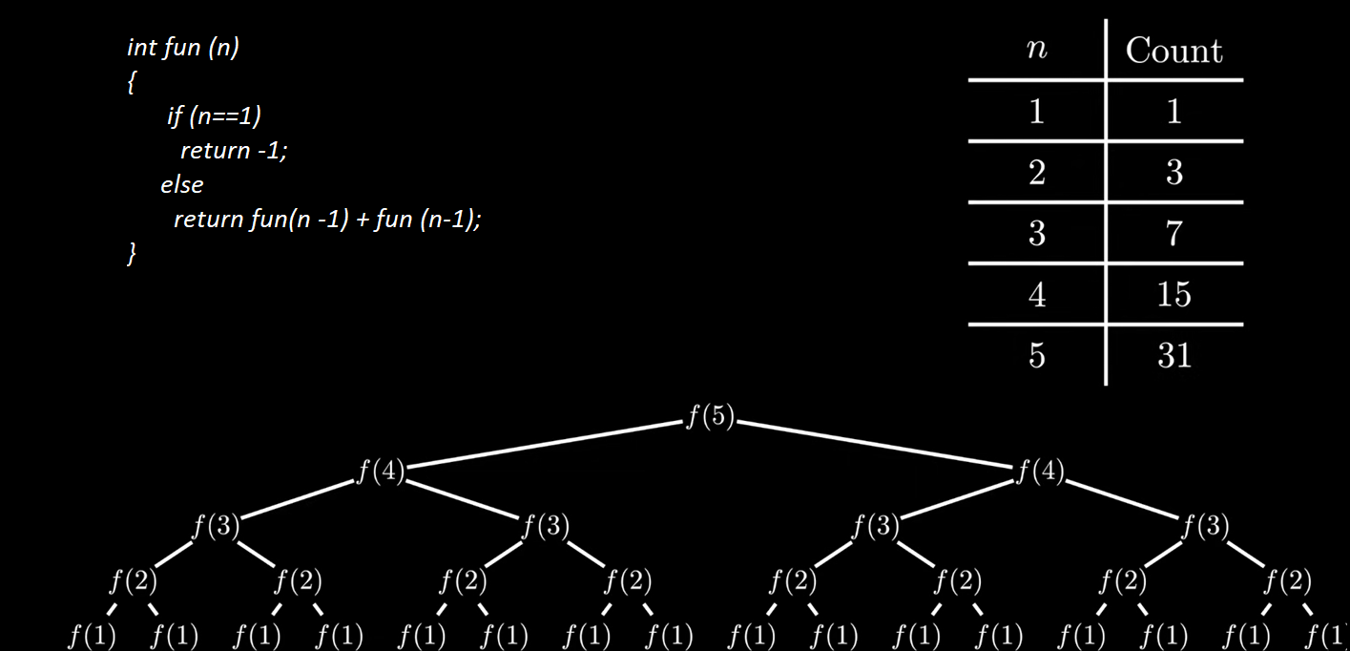

Slide 25
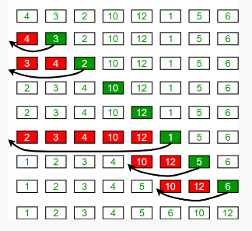
Activity

